Slide 1
National Institute of Technology Calicut
Department of Electronics and Communication Engineering
SPEECH SYNCHRONIZED TALKING FACE GENERATION
FROM AN IMAGE AND AN EMOTION CONDITION
Group - 42
Anjalin Anna Cherian (B191085EC) | Maneesha A Pillai (B191081EC) | R Avaneesh (B190193EC)
Sanka Anjani (B190804EC) | Shaheen Rafiq (B190985EC)
Guided By
Dr Ameer PM

Slide 2
Contents
Objective
Speech Gan
Block Diagram
Architecture
Loss Function
Loss Function
Training
Dataset
Improvements
SE Networks
Eyeloss using MTCNN
Super resolution - BSRGAN
Outputs
Conclusion
Future Scope
Previous Work
Different Models
Different Emotions
Group members & celebrities
Evaluation Metrics
Block Diagram
Implementation

Slide 3
Objective
We aim to enhance the performance of the Speech Synchronized talking face Generator model, which generates emotionally expressive talking faces using Generative Adversarial Networks (GAN).
To achieve this goal, we conducted a comprehensive study on the working principles of GANs, autoencoders, and adversarial autoencoders. We will also implement these models using Python.
Additionally, we conducted a thorough literature review on facial expression manipulation and used our findings to design and implement the model and improve it.
To evaluate the effectiveness of our improved outputs, we will use both subjective and objective evaluation metrics. The subjective evaluation metric we will employ is the Mean Opinion Score (MOS), while the objective evaluation metric is the Frechet Inception Distance (FID).

Slide 4
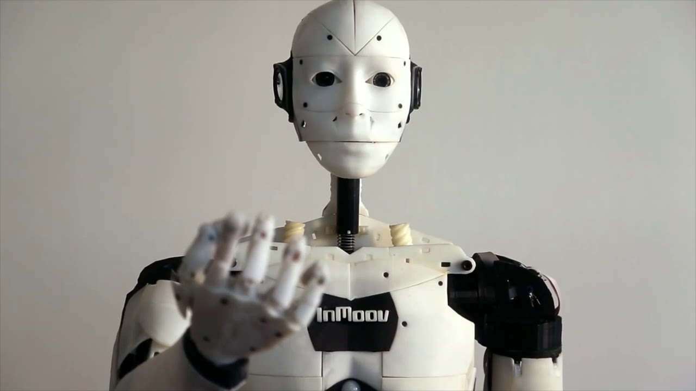
Applications of the Project
Improves accessibility of audio-only resources
Acts as a tool for behavioral psychologists
Enhances quality of human-machine interactions

Slide 5
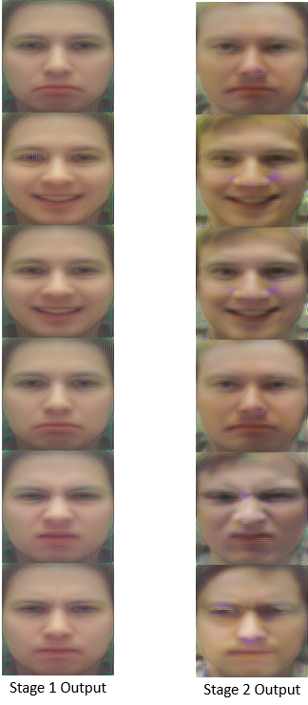
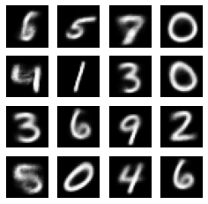
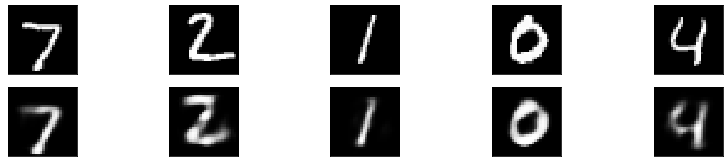
Previous Work
ExprGAN a novel method for generating emotional face images
We have implemented the following:
Adversarial Autoencoder to generate digits on MNIST Dataset
Autoencoder to generate digits on MNIST Dataset
Fig 1. Autoencoder Output
Fig 2. Adversarial Autoencoder Output
Fig 3. ExprGAN Output

Slide 6
Speech GAN
We implemented the following Speech GAN model. The system uses GAN architecture with a generator and discriminator, taking speech waveforms and reference images as input with preconditioned settings to generate a video with a talking face. The architecture is as follows:
Components | Input | Layers | Output
Speech Encoder | Input waveform | 1-D convolutional layers context layer, LSTM layers | Speech Embedding Sequence
Image Encoder | Input condition image | 2-D Convolutional (x6) with LeakyReLU | Image Embedding
Noise Encoder | Gaussian noise vector for each video frame | Single-layer LSTM | Noise Embedding
Emotion Encoder | One-hot emotion vector | Two-layer FC Neural Network with LeakyReLU | Emotion Embedding
Video Decoder | Speech, image, noise, and emotion embeddings | Convolutional Layers with Skip Connections | Generated video
Frame Discriminator | Video frames (real or generated) | 5 Convolutional Layers and 2 Fully Connected Layers | Real/Fake Classification for each Frame
Emotion Discriminator | Generated video frames | 5 Convolutional Layers and 2 Fully Connected Layers | Classification of Emotional Expression
ENCODER
DECODER
DISCRIMINATOR

Slide 7
Speech GAN
Objective functions used for the generator step in the model include an MRM loss to enhance mouth-audio synchronisation, an emotion discriminator loss to improve emotional expression, a frame discriminator loss to improve image quality, and a perceptual loss to improve picture quality. The complete objective function for the generator loss is a weighted sum of these components.
J_{GEN} = αL₁^{MRM} + βL₂^{Perceptual} +γ J_{FD} + δJ_{ED}
J_{GEN} represents the Generator Loss
L₁^{MRM} represents the MRM Loss.
L₂^{Perceptual} is the Perceptual Loss.
J_{FD} is the Frame GAN Loss.
J_{ED} is the Emotional GAN Loss.
α, β, γ and δ are the respective weights of each component.

Slide 8

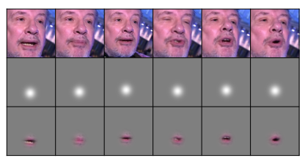
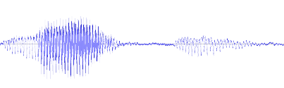
Block Diagram of the Original Architecture
WGAN-GP
Image Encoder
Frame Discriminator
Speech Encoder
MRM + Perceptual Loss
Decoder
Real
Data
z
Noise Encoder
Emotion Discriminator
Emotion Encoder

Slide 9
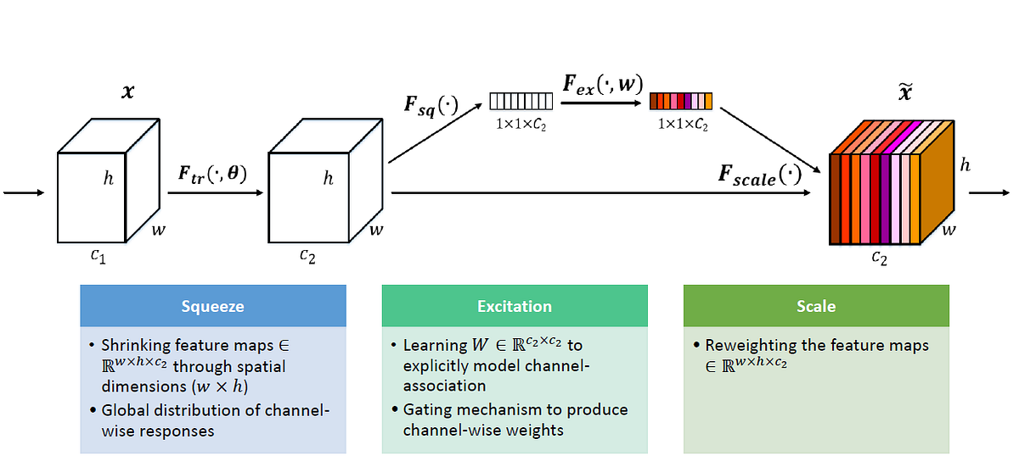
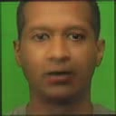
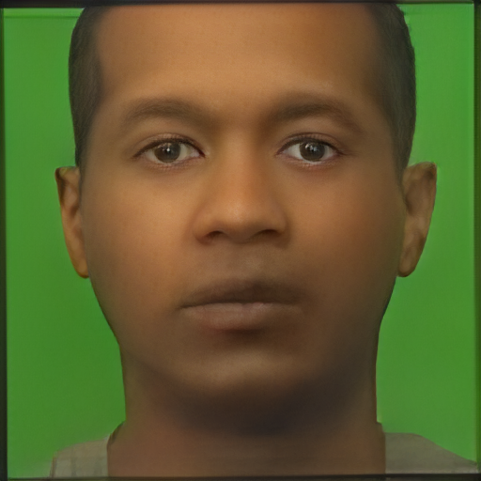
Improvements
Squeeze and Excitation Network
(SE Net)
Multi-task Cascaded Convolutional Networks (MTCNN)
Multi-task Cascaded Convolutional Networks (MTCNN)
MTCNN is a neural network which detects faces and facial landmarks on images.
MTCNN was used in order to detect the eye region from which we generate an eye region mask.
The L1 loss between the generated and ground truth eye region masks is added to the total loss.
Squeeze and Excitation or SE network is a type of neural network architecture that can improve the performance of CNNs in various computer vision tasks.
We have implemented the SE network in the Image encoder and have seen that the output has improved significantly.
Fig 4. Architecture of Squeeze and Excitation Networks
MTCNN is a neural network which detects faces and facial landmarks on images.
MTCNN was used in order to detect the eye region from which we generate an eye region mask.
The L1 loss between the generated and ground truth eye region masks is added to the total loss.
Base Paper
With SE Network

Slide 10
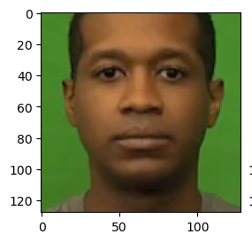
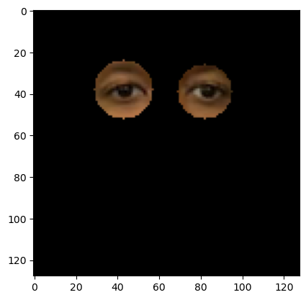
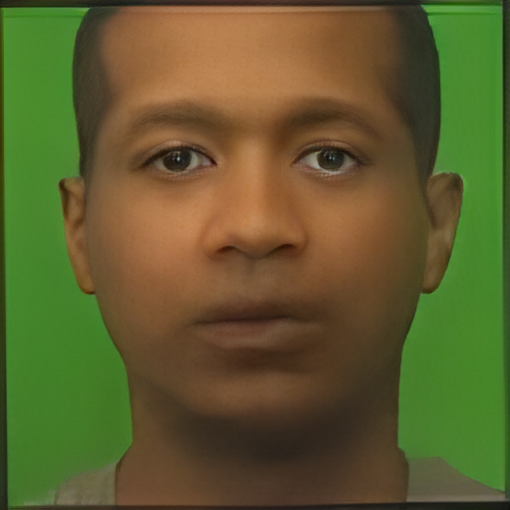
Improvements
Input frame
Base Paper
Multi-task Cascaded Convolutional Networks (MTCNN)
MTCNN is a neural network which detects faces and facial landmarks in images.
MTCNN was used in order to detect the eye region from which we generated an eye region mask.
The L1 loss between the generated and ground truth eye region masks is added to the total loss.
The modified objective function is as follows:
J_{GEN} = αL₁^{MRM} + βL₂^{Perceptual} +γ J_{FD} + δJ_{ED} + ε L₁^{EL}
Blind Image Super-Resolution (BSRGAN)
BSRGAN is used as it can perform blind super-resolution on new, unseen and low-resolution images.
Using BSRGAN, the resolution of the output video improved greatly.
BSRGAN was run for each of the frames of the video. The frames are then sewn back together.
Where L₁^{EL} represent the calculated eye loss, and ε is the corresponding weight associated with it and is taken as 1 in our case.
With Eye Mask
Eye Mask

Slide 11
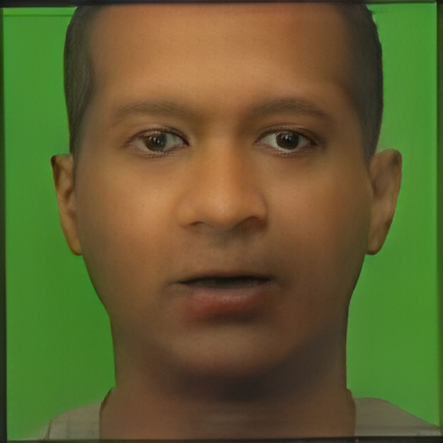
Improvements
Input Frame – 128 x128
Blind Image Super-Resolution (BSRGAN)
Multi-task Cascaded Convolutional Networks (MTCNN)
MTCNN is a neural network which detects faces and facial landmarks on images.
MTCNN was used in order to detect the eye region from which we generate an eye region mask.
The L1 loss between the generated and ground truth eye region masks is added to the total loss.
BSRGAN is used as it can perform blind super-resolution on new, unseen and low-resolution images.
Using BSRGAN, the resolution of the output video improved significantly.
BSRGAN was run for each of the frames of the video. The frames are then sewn back together.
Output Frame – 512 x 512

Slide 12
Block Diagram of the improved Architecture
WGAN-GP
Image Encoder
With SE Network
Frame Discriminator
Speech Encoder
MRM +Eye Loss Perceptual Loss
Decoder
Real
Data
Noise Encoder
BSRGAN
z
Emotion Discriminator
Emotion Encoder
Note: The highlighted elements represent all the additional networks added to improve the model.

Slide 13
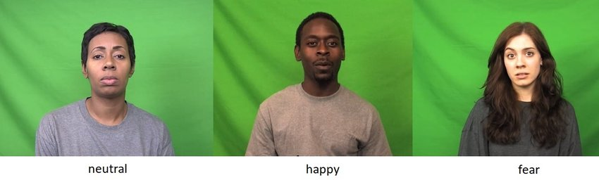

Dataset
We used crowd-sourced Emotional Multimodal Actors or CREMA-D for our model.
It contains 7,442 original clips from 91 actors who were made to speak short phrases from 12 sentences while displaying a wide range of emotions, specifically anger, disgust, fear, happiness, neutral and sadness.
These videos are sampled at 30 Frames per second(FPS), while the speech is sampled at 44.1 kHz. The videos have an image resolution of 480x360.
The pre-processing of the dataset used in the model includes downsampling the video to 25 FPS and audio to 8 KHz.
neutral
happy
Disgust
Fig 5. Examples of frames from the CREMA-D dataset along with the corresponding emotion labels.

Slide 14
Implementation
 | Base Paper | Base Model | With Se Network and Eye Loss | On Dgx Machine
Dataset used | CREMA-D | CREMA-D | CREMA-D | CREMA-D
No. of videos used for training | 7442 | 100 | 100 | 100
Optimizer used: | Adam | Adam | Adam | Adam
Batch size | 8+8+4 | 2+2+2 | 2+2+2 | 2+2+2
No. of epochs | 108 + 108+54 | 500+500+200 | 500+500+200 | 1600+1600+2000
Learning Rate | 1e-5 (For the Generator) 1e-4 (For the Discriminators) | 1e-5 (For the Generator) 1e-4 (For the Discriminators) | 1e-5 (For the Generator) 1e-4 (For the Discriminators) | 1e-5 (For the Generator) 1e-4 (For the Discriminators)
GPU Used | GTX 1060TI | P100 | P100 | A100

Slide 15
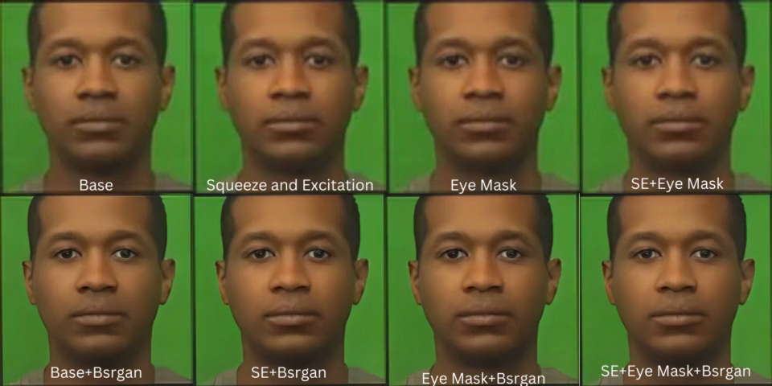
Output
The output videos are produced by the model with various combinations between SE network, Bsrgan, and Eye mask.

Slide 16
Metrics

Slide 17
Metrics

Slide 18
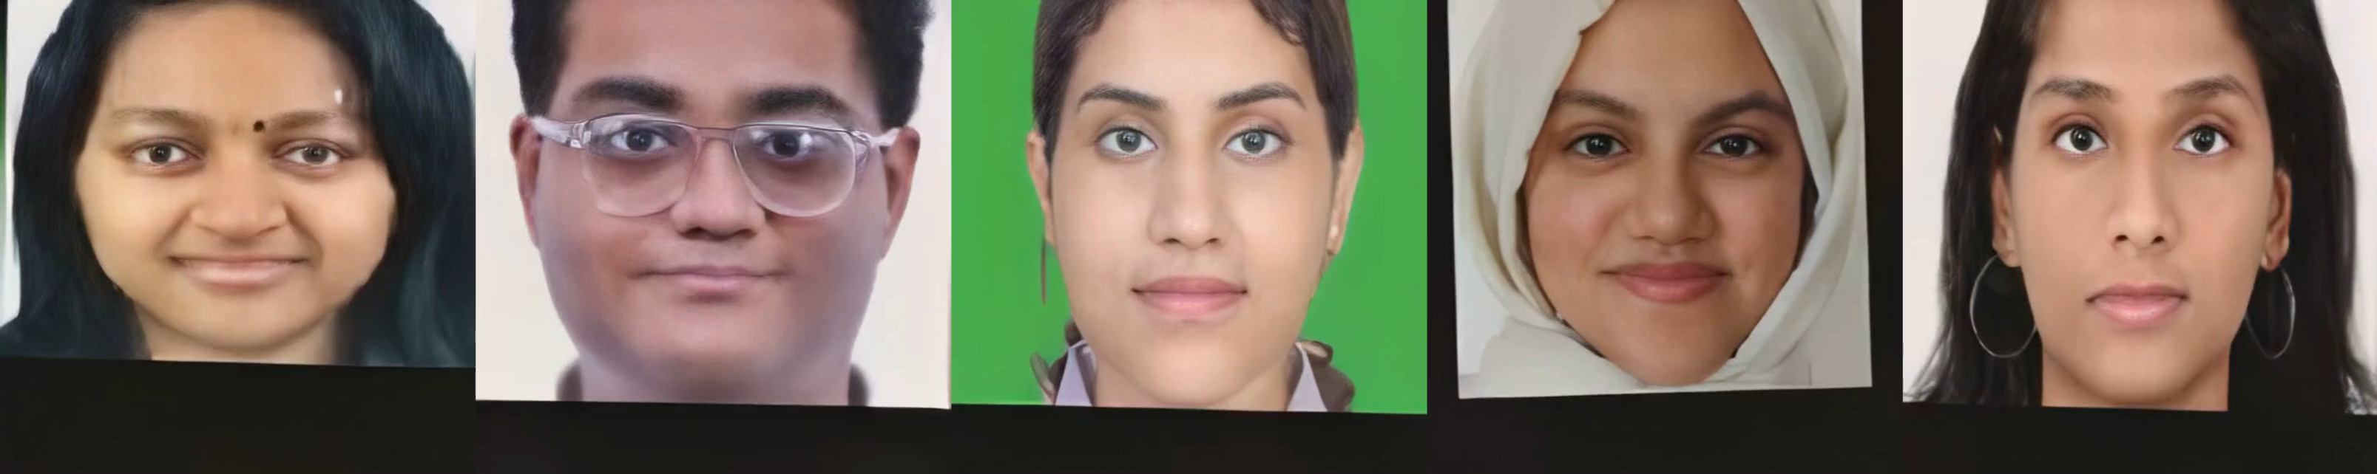
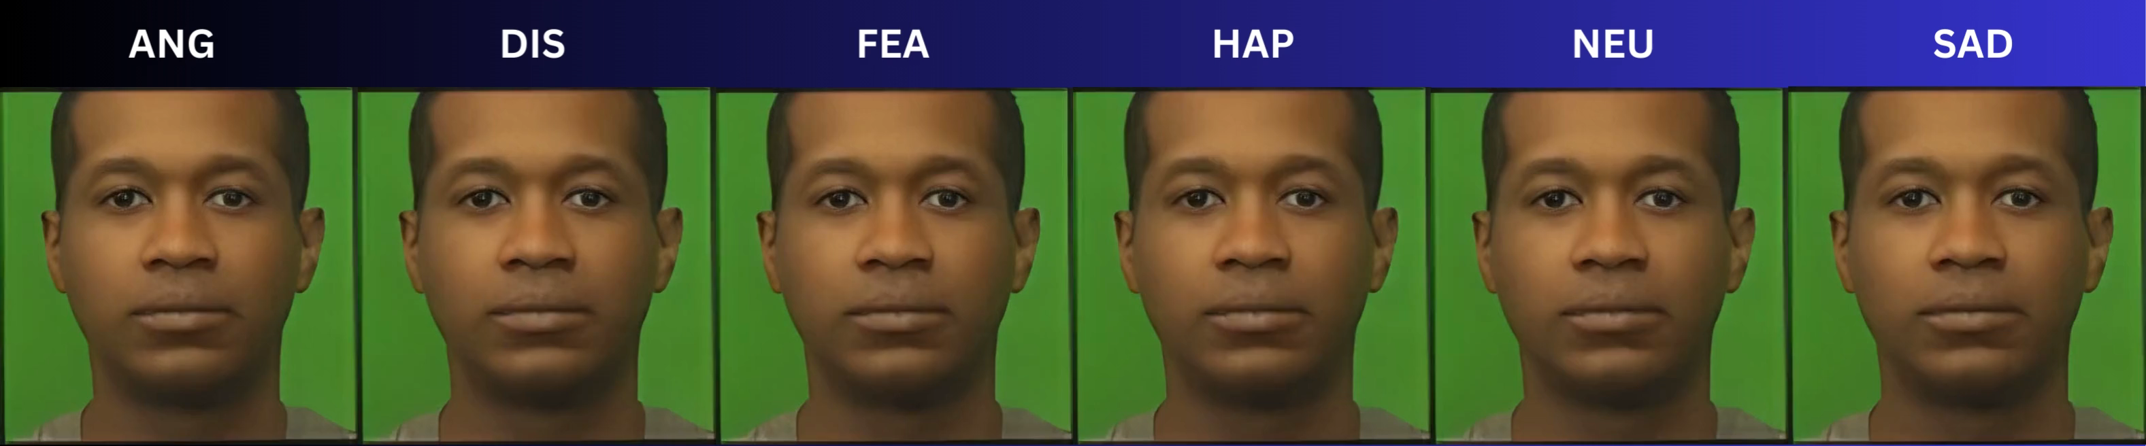
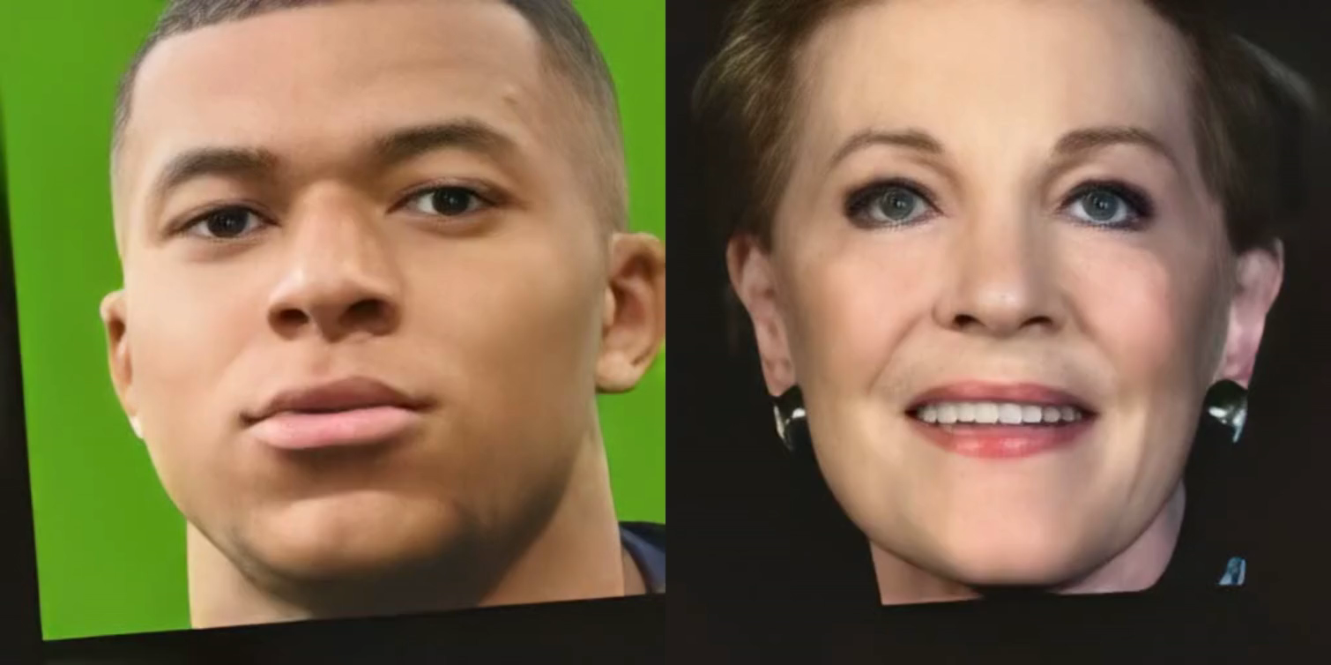
Output of Final Model
Different Emotions

Slide 19
Output of Final Model
Group Member's Faces
Celebrity Faces

Slide 20
Conclusion
We implemented an emotional talking face model that is conditioned on a speech signal, a reference image, and categorical emotion inputs. We used an incremental training approach to optimize the model's performance. To improve the resolution of the outputs, we implemented BSRGAN.
To calculate the eye loss, we used MTCNN to detect the eye region and applied L1 loss between the features of the eye, which was then added to the total loss. Additionally, we incorporated a squeeze and excitation neural network to enhance the efficiency and performance of the CNNs present in our model.
The evaluation metrics demonstrated that our modified model has significantly better outputs, indicating that our approach is effective.
Future Scope
Improve the model outputs on faces outside the CREMA-D dataset.
Further fine-tune the model to handle substandard and low-resolution images.
Train our model for the whole dataset using a more powerful GPU.

Slide 21
References
S. E. Eskimez, Y. Zhang, and Z. Duan, “Speech driven talking face generation from a single image and an emotion condition,” IEEE Transactions on Multimedia, vol. 24, pp. 3480–3490, 2021.
J. Hu, L. Shen, and G. Sun, “Squeeze-and-excitation networks,” in Proceedings of the IEEE Conference on computer vision and pattern recognition, 2018, pp. 7132–7141.
J. Xiang and G. Zhu, “Joint face detection and facial expression recognition with MTCNN,” in 2017 4th international conference on information science and control engineering (ICISCE), IEEE, 2017, pp. 424–427.
Zhang, J. Liang, L. Van Gool, and R. Timofte, “Designing a practical degradation model for deep blind image super-resolution,” in Proceedings of the IEEE/CVF International Conference on Computer Vision, 2021, pp. 4791–4800.
H. Cao, D. G. Cooper, M. K. Keutmann, R. C. Gur, A. Nenkova, and R. Verma, “Crema-d: Crowd-sourced emotional multimodal actors dataset,” IEEE Transactions on affective computing, vol. 5, no. 4, pp. 377–390, 2014.
H. Ding, K. Sricharan, and R. Chellappa, “Exprgan: Facial expression editing with controllable expression intensity,” in Proceedings of the AAAI conference on artificial intelligence, vol. 32, 2018.

Slide 22
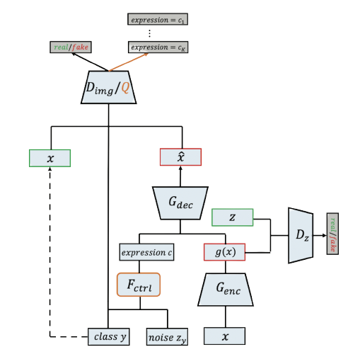
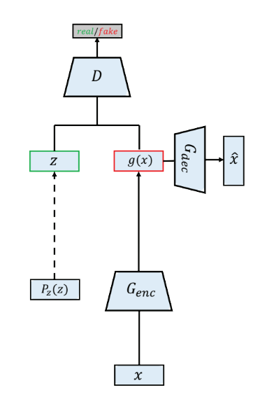
Architecture: Previous work
Expression GAN
Adversarial Autoencoder

